Slide 1
Will Large-scale Generative Models Corrupt Future Datasets?
BY:
Soumyadeep Chakraborty -21dcs010
Utkarsh Gupta -21ucs222
Anubhav Sharma-21ucs024

Slide 2
Introduction
Background:
Deep generative models depend heavily on large, labeled datasets for effective training. However:
Acquiring real-world data is often time-consuming, expensive, and prone to biases.
Synthetic data, generated using deep generative models, offers a cost-effective alternative by augmenting or replacing real data.
Despite its advantages, synthetic data introduces challenges:
Does it accurately capture the diversity and complexity of real data?
Can models trained on synthetic data generalize well to real-world scenarios?
Motivation:
Synthetic data is widely used in fields like computer vision, NLP, and healthcare. However, its quantifiable impact on model performance, especially when mixed with real data, remains underexplored.
Understanding these impacts is crucial to determine when and how synthetic data can effectively be integrated into training pipelines.

Slide 3
Introduction
Objectives:
Evaluate the impact of synthetic data contamination ratios (0%, 20%, 40%, 60%, 80%) on three key tasks:
Image Classification: Measure how well models classify CIFAR-10 categories when trained with mixed data.
Image Captioning: Assess the ability of models to generate captions for CIFAR-10 images under varying contamination.
Image Generation: Analyze the fidelity of synthetic images produced by a generator network.

Slide 4
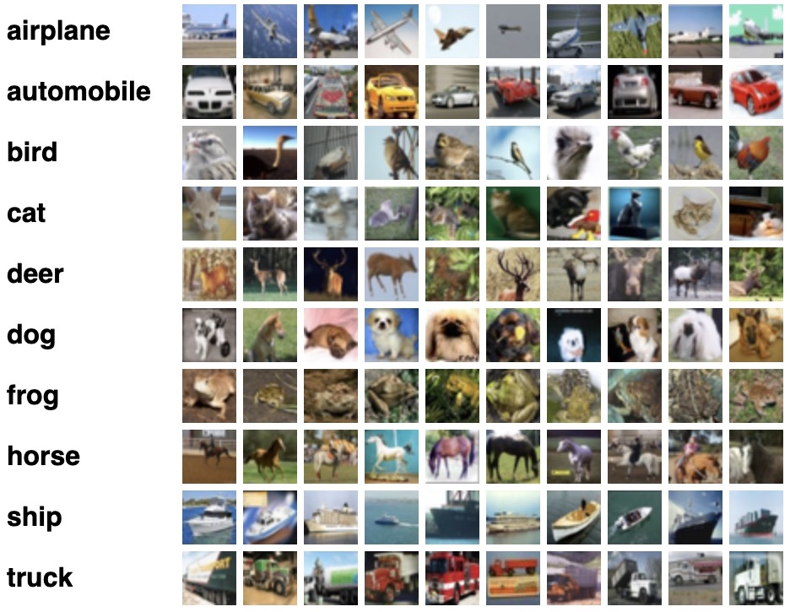
Dataset used for evaluation
CIFAR-10(Canadian Institute for Advanced Research) Dataset
60,000 32x32 color images, equally distributed across 10 classes.
Classes:
Airplane, Automobile, Bird, Cat, Deer, Dog, Frog,
Horse, Ship, Truck.
Dataset Split:
50,000 training images.
10,000 test images.
Training data shape: (50000, 32, 32, 3), Test data shape: (10000, 32, 32, 3)

Slide 5
Models used for the study
1. ResNet-18 (For Image Classification)
Purpose:
The ResNet-18 model is used to perform image classification on the CIFAR-10 dataset, which consists of 10 different categories of images (e.g., airplane, cat, dog, etc.).
ResNet-18 is selected due to its ability to train deep networks efficiently through residual connections, addressing the vanishing gradient problem.
Why Chosen:
Efficient and High Accuracy: ResNet-18 strikes a balance between depth and computational efficiency, making it well-suited for CIFAR-10 classification, which is a relatively simple task but requires handling a variety of image categories.
Residual Connections: The residual connections prevent the network from suffering due to vanishing gradients, making it easier to train deep networks effectively.

Slide 6
Architecture:
Input: A 32x32 pixel image from the CIFAR-10 dataset (3 color channels).
Key Components:
Initial Convolution Layer: A 7x7 convolution with 64 filters followed by batch normalization and ReLU activation.
Residual Blocks: The core of ResNet-18 consists of 4 residual blocks, each containing two 3x3 convolutional layers.
The first block has 64 filters, the second block has 128 filters, the third with 256 filters, and the fourth with 512 filters.
Each block uses skip connections (or residual connections) to bypass some convolutional layers, which helps with deeper network training.
Global Average Pooling (GAP): Reduces the output from the last residual block to a fixed size (1x1 feature map).
Fully Connected Layer: This layer outputs 10 class probabilities, corresponding to the 10 categories in CIFAR-10.

Slide 7
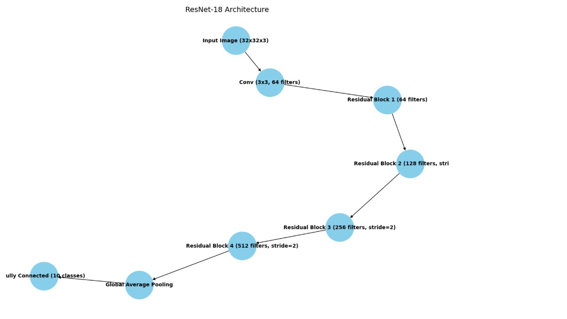
Architecture
Input Image (32x32x3)
↓
Convolution (7x7, stride=1) → BatchNorm → ReLU
↓
Residual Block 1 (64 filters, 2 blocks)
↓
Residual Block 2 (128 filters, stride=2, 2 blocks)
↓
Residual Block 3 (256 filters, stride=2, 2 blocks)
↓
Residual Block 4 (512 filters, stride=2, 2 blocks)
↓
Global Average Pooling
↓
Fully Connected (10 classes)

Slide 8
Models used for study
2. Generator (For Synthetic Data Generation)
Purpose:
The Generator model is used to generate synthetic images that mimic the real CIFAR-10 images.
The synthetic images are then used to contaminate the CIFAR-10 dataset at varying ratios (e.g., 0%, 20%, 40%, 60%, and 80%), to study the impact of synthetic data on classification and captioning tasks.
Why Chosen:
Simple yet Effective: This generator architecture is simple and effective for generating CIFAR-10-like images, providing a controlled way to study synthetic data's effect on model performance.
Data Augmentation: The synthetic data generated by this model helps augment the CIFAR-10 dataset, creating variations of real images to test how models trained on mixed datasets (real + synthetic) perform.

Slide 9
Architecture:
Input: A 100-dimensional latent vector (often sampled from a Gaussian distribution), which serves as the random input (noise) to the generator.
Key Components:
Fully Connected Layer: The latent vector is passed through a fully connected layer, reshaping it to a higher-dimensional feature map (in this case, 8x8x128).
Reshape: The fully connected output is reshaped into a tensor of size (8x8x128), which will then be progressively upsampled into a larger image.
Transposed Convolutions (Upsampling):
First Transposed Conv Layer: Upsamples the feature map from (8x8x128) to (16x16x128).
Second Transposed Conv Layer: Upsamples to (32x32x64).
Third Transposed Conv Layer: Final layer to generate (32x32x3), which corresponds to an RGB image.
Activation Functions:
ReLU: Used in all hidden layers to introduce non-linearity.
Tanh: The final output layer uses the Tanh activation function to scale the pixel values of the generated images to the range [-1, 1].

Slide 10
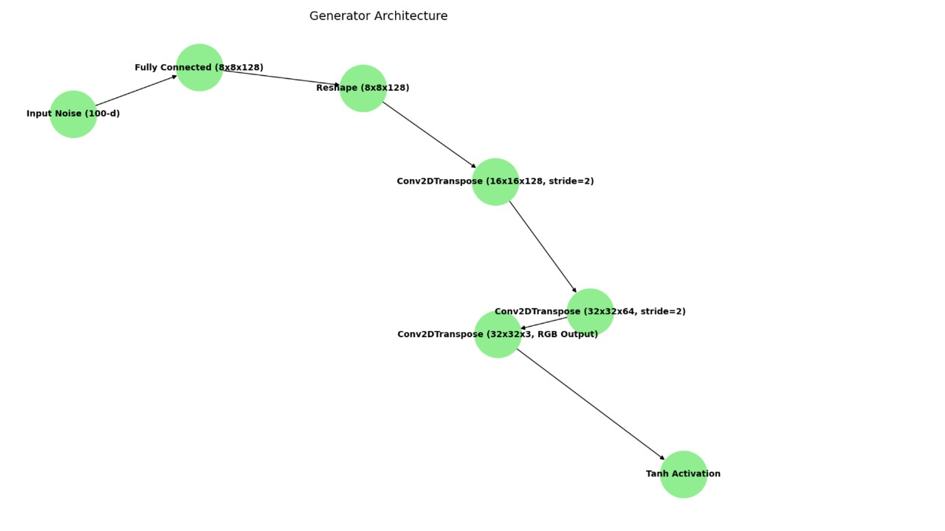
Architecture
Input Noise (100-dimensional)
↓
Fully Connected (8x8x128 feature map)
↓
Reshape → (8x8x128)
↓
Conv2DTranspose → (16x16x128)
↓
Conv2DTranspose → (32x32x64)
↓
Conv2DTranspose → (32x32x3, RGB Output)
↓
Tanh Activation (Output Range: [-1, 1])

Slide 11
Models used for study
3. Encoder-Decoder Model (For Image Captioning)
Purpose:
The Encoder-Decoder model is used to generate captions for CIFAR-10 images, describing the object class in a human-readable format (e.g., "A dog in the image").
The Encoder is responsible for extracting meaningful features from the images, and the Decoder generates a sequence of words (the caption) from the extracted features.
Why Chosen:
Sequence-to-Sequence Architecture: The Encoder-Decoder architecture is ideal for tasks where the input (image) needs to be mapped to an output sequence (caption).
CNN + LSTM Combination: Using a CNN for feature extraction and an LSTM for sequence generation is a well-established approach for image captioning tasks, enabling the model to effectively handle both image and text data.

Slide 12
Architecture:
Encoder (CNN):
Input: A CIFAR-10 image (32x32x3).
The image is passed through convolutional layers to extract features.
The output is then pooled using Global Average Pooling (GAP), reducing the spatial dimensions to a fixed-size vector (a summary of the image content).
This feature vector is then passed to the Decoder.
Decoder (LSTM):
Input: The encoded image features (vector).
The decoder uses an Embedding layer to convert each word of the caption into a dense vector.
The word embeddings are passed to an LSTM layer, which processes the sequence of words and generates the next word in the caption.
RepeatVector is used to repeat the encoded image features for each word in the generated caption.
The LSTM output is combined with the encoded image features, and the final output layer predicts the next word using a TimeDistributed Dense Layer.
The model generates a sequence of words, which form the complete caption.

Slide 13
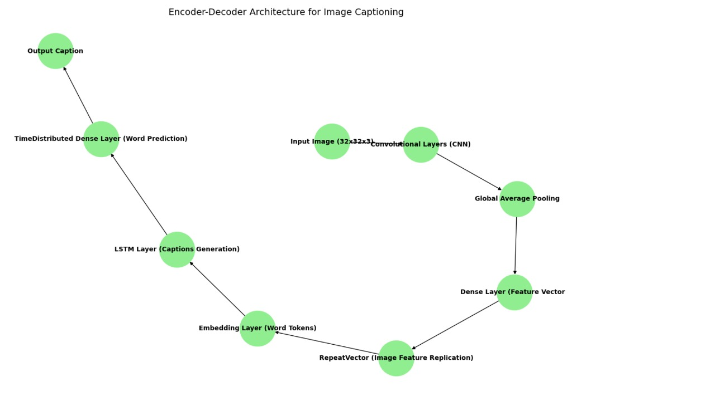
Architecture
+---------------------+ +--------------------------+
| Input Image | | Decoder Input |
| (32x32x3) | | (Caption words) |
+---------------------+ +--------------------------+
↓ ↓
+---------------------+ +--------------------------+
| Convolutional | | Embedding Layer |
| Layers (CNN) | | (Word tokens → Dense) |
+---------------------+ +--------------------------+
↓ ↓
+---------------------+ +--------------------------+
| Global Average | | LSTM Layer |
| Pooling (GAP) | | (Captions Generation) |
+---------------------+ +--------------------------+
↓ ↓
+---------------------+ +--------------------------+
| Dense Layer | | RepeatVector (Image |
| (Feature Vector) | | Feature Replication) |
+---------------------+ +--------------------------+
↓ ↓
+---------------------+ +--------------------------+
| Output | | TimeDistributed Dense |
| (256-d vector) | | (Word prediction) |
+---------------------+ +--------------------------+
↓ ↓
+-------------------+ +--------------------------+
| Caption: "A dog | | Output Caption |
| in the image" | | (Generated sequence) |
+-------------------+ +--------------------------+

Slide 14
Task 1: Image classification
Purpose:
The image classification task focuses on training models to classify CIFAR-10 images into one of 10 categories (e.g., airplane, dog, car, etc.).
The task is aimed at evaluating how synthetic data contamination affects model performance on real-world image classification tasks.
Methodology:
Model: ResNet-18 is used for the image classification task. ResNet-18 is a deep convolutional neural network (CNN) that uses residual connections to train deeper models more efficiently.
Synthetic Data Generation:
Synthetic images are generated using a Generator model that creates 32x32 RGB images resembling the CIFAR-10 dataset.
These synthetic images are used in combination with real CIFAR-10 images, mixed at varying contamination ratios (0%, 20%, 40%, 60%, 80%).
Contamination Ratios:
The real CIFAR-10 dataset is mixed with synthetic data at different contamination ratios to study the impact on classification accuracy.
The task evaluates how well the model generalizes when trained with varying proportions of synthetic data.

Slide 15
Task 1: Image classification
Evaluation:
Metrics:
Training Accuracy: Measures how well the model performs on the mixed training dataset (real + synthetic).
Validation Accuracy: Measures the model’s performance on the real CIFAR-10 test dataset.
Why It's Important:
This task helps assess the real-world viability of using synthetic data in image classification tasks.
The goal is to study how synthetic data impacts the model's ability to generalize to new, unseen images (test data).

Slide 16
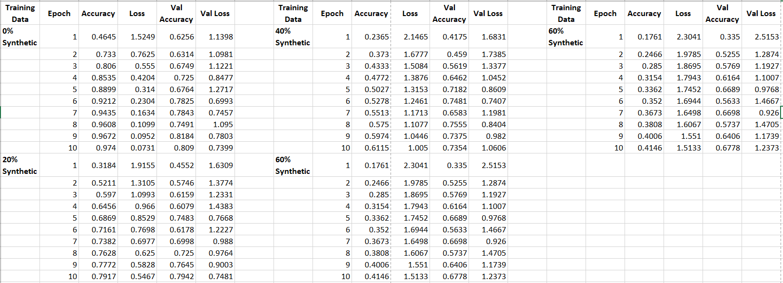
Evaluation

Slide 17
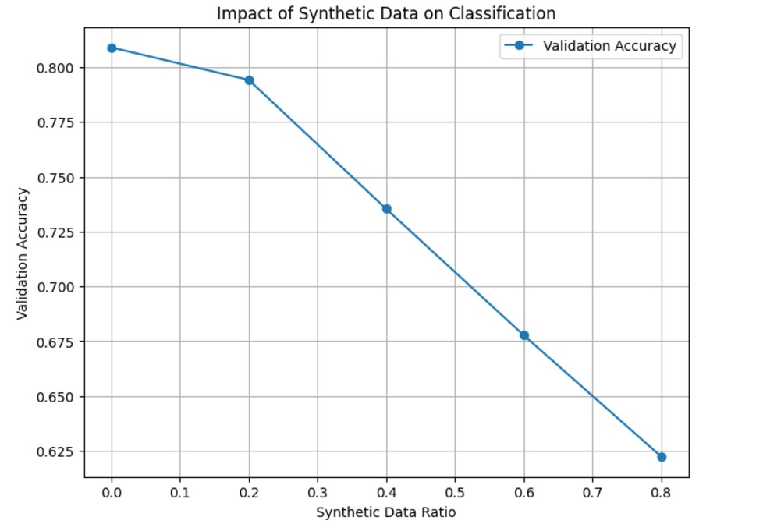
Visualization

Slide 18
Task 2: Image captioning
Purpose:
The image captioning task involves generating human-readable captions for images.
For this study, the captions describe the object in the image (e.g., "A dog in the image"). The objective is to assess how synthetic data affects the model’s ability to generate meaningful captions for images.
Methodology:
Model: An Encoder-Decoder architecture is used.
The Encoder is a CNN that extracts features from the image.
The Decoder is an LSTM that generates captions word by word based on the extracted features.
Synthetic Data Generation:
Similar to Task 1, synthetic images are generated using the Generator model.
These synthetic images are mixed with real CIFAR-10 images at different contamination ratios (0%, 20%, 40%, 60%, 80%).
The model is trained to predict the next word in the caption sequence given the image features.
Contamination Ratios:
The CIFAR-10 captions (created from real images) are used for the training of the model, and the task examines how the model handles contamination with synthetic images and their corresponding (possibly noisy) captions.

Slide 19
Task 2: Image captioning
Evaluation:
Metrics:
Training and Validation Accuracy: Measures the model's ability to predict the correct caption given an image.
Why It's Important:
This task evaluates how well a model trained on mixed datasets (real and synthetic images) can generate captions that accurately describe images.
It helps understand the effectiveness of synthetic data in a sequence generation task like captioning.

Slide 20
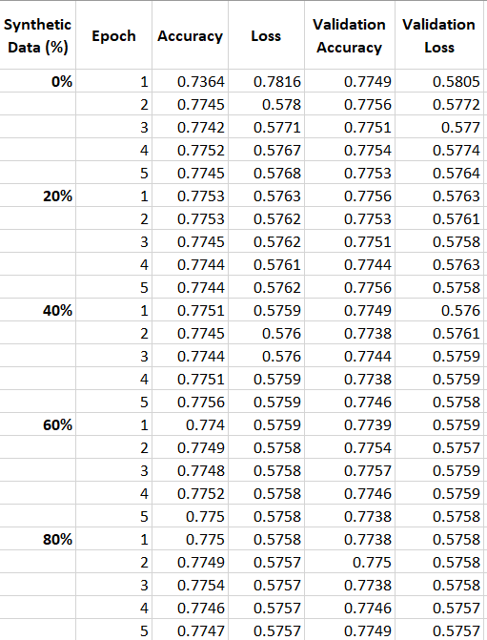
Evaluation

Slide 21
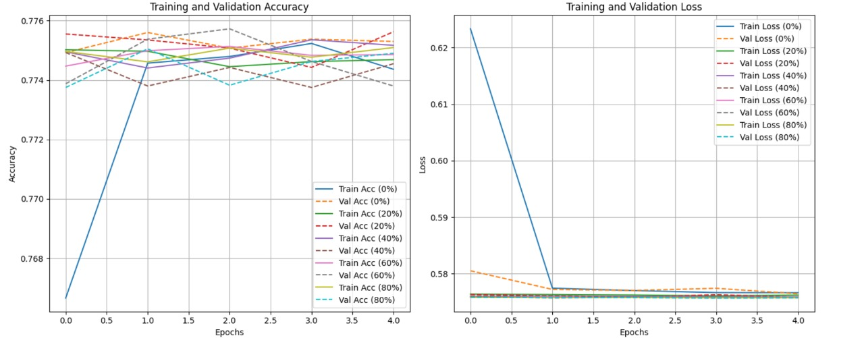
Visualization

Slide 22
Task 3: Image generation
Purpose:
The image generation task is focused on using a Generator model to produce synthetic images that resemble real CIFAR-10 images.
The objective is to study the quality of synthetic images generated by the model, and how well they match the real data distribution.
Methodology:
Model: The Generator model is a feed-forward neural network with transposed convolution layers (also called deconvolution layers).
The generator takes a latent vector (random noise) as input and generates an image from it.
The output is a 32x32 RGB image similar to the CIFAR-10 dataset.
Synthetic Data Generation:
Synthetic images are generated by sampling from a random latent space.
These generated images are then compared to real CIFAR-10 images using Frechet Inception Distance (FID) to evaluate the quality of the generated images.
Contamination Ratios:
The synthetic images are mixed with real CIFAR-10 images at different contamination ratios (0%, 20%, 40%, 60%, 80%) to study the impact of synthetic data on classification and captioning tasks.
The aim is to determine how well the synthetic images preserve the properties of real images and their utility for training models.

Slide 23
Task 3: Image generation
Metrics:
Frechet Inception Distance (FID): FID measures the similarity between the real and generated image distributions. A lower FID score indicates that the generated images are of higher quality and more similar to real images.
Why It's Important:
This task evaluates the quality of synthetic images produced by the Generator model and how they can be used in data augmentation for classification and captioning tasks.
The goal is to understand the potential of generative models in creating synthetic data that can be used for training without compromising on quality.

Slide 24
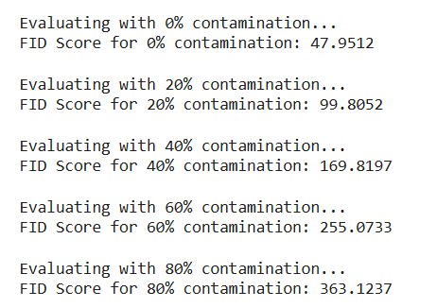
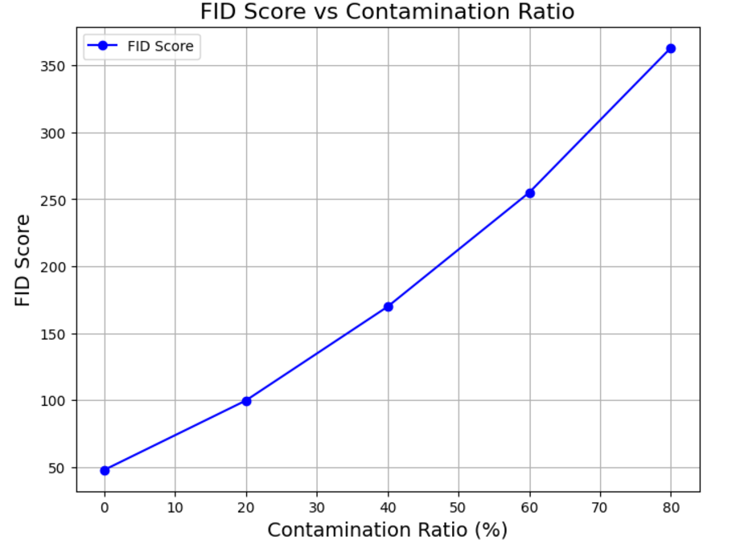
Evaluation and Visualization

Slide 25
Summary and Conclusion
Summary:
This study investigates the impact of synthetic data contamination on image classification, image captioning, and image generation tasks using the CIFAR-10 dataset. The main findings include:
Image Classification:
Higher synthetic data contamination led to decreased validation accuracy, highlighting challenges in generalization.
Image Captioning:
While synthetic data improved training accuracy, validation accuracy remained relatively stable across different contamination ratios.
This suggests that synthetic data might help in training the model but doesn't significantly impact the overall quality of generated captions for real data.
Image Generation:
FID scores revealed that the quality of synthetic images worsened with higher contamination ratios, indicating lower realism.
Conclusion:
Synthetic data can augment training, but high contamination ratios can impact image classification and generation tasks. For image captioning, synthetic data improved training but didn't significantly impact validation accuracy, suggesting that careful tuning of synthetic data quality is essential.

